Slide 1
NFL Betting Lines:
An Analysis

Slide 2
Brief Primer on NFL Betting
The two most common bets are spread bets and totals bets.
A spread bet consists of an amount of points that one team receives, and the other team is deducted (e.g. “lays”)
Spread bets exist because two teams are seldom equal. The spread is meant to level the playing field from a gambling standpoint (similar to a handicap in golf)
A totals bet consists of a single number that represents the predicted total score of the game (both home team and away team combined).
Bettors choose either Over or Under. Over bettors think the score will be higher than the total and under bettors think the score will be lower than the total

Slide 3
Our Analysis: Purpose
The basis for our analysis revolved around the commonly accepted wisdom that “Vegas is always right”. Put more simply, that the outcomes of the game against the betting lines are no more than a coinflip. After a straightforward analysis of the last 10 years of NFL betting outcomes, we decided to study two specific relationships:
Betting outcomes as they relate to location (home vs away)
Betting outcomes as they relate to divisional games

Slide 4
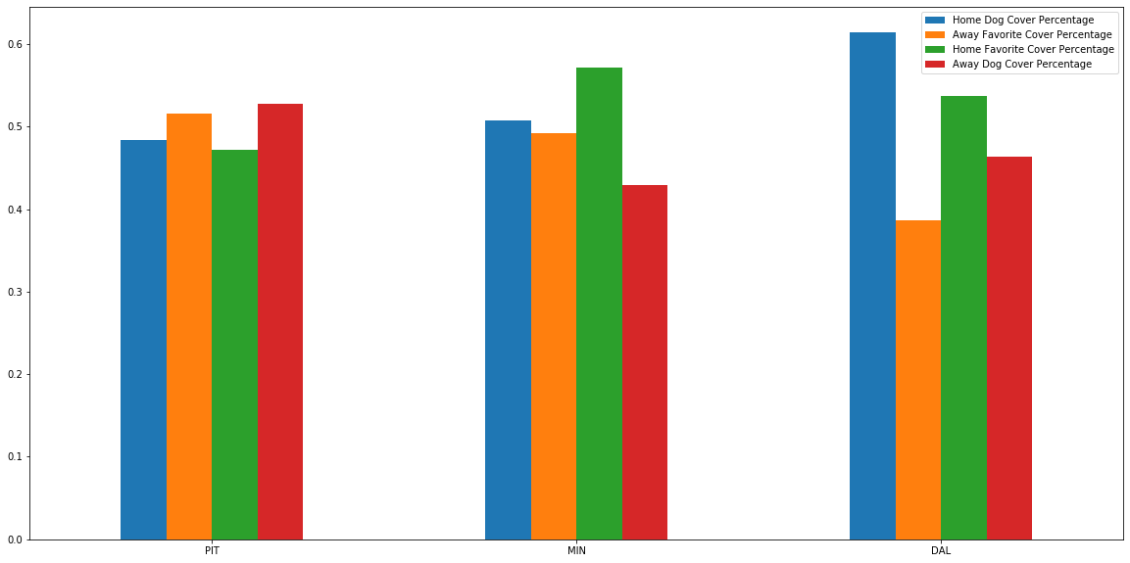
Spread Coverages: Favorite vs Dog

Slide 5
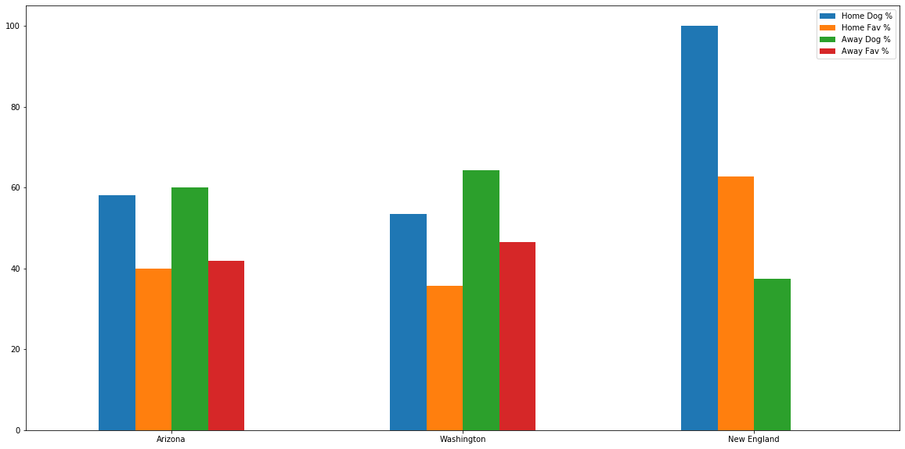
Cover Percentages Against the Spread: Home

Slide 6
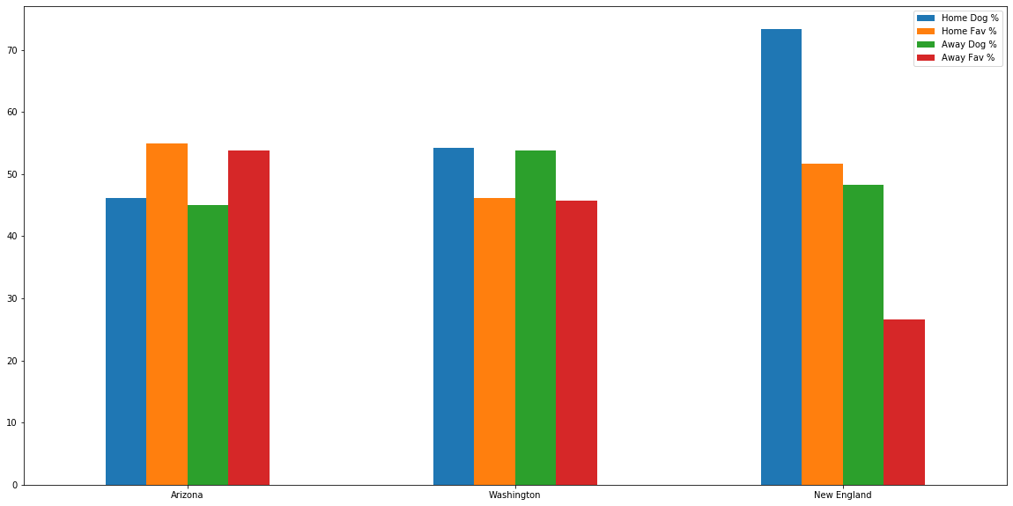
Cover Percentages Against the Spread: Away

Slide 7
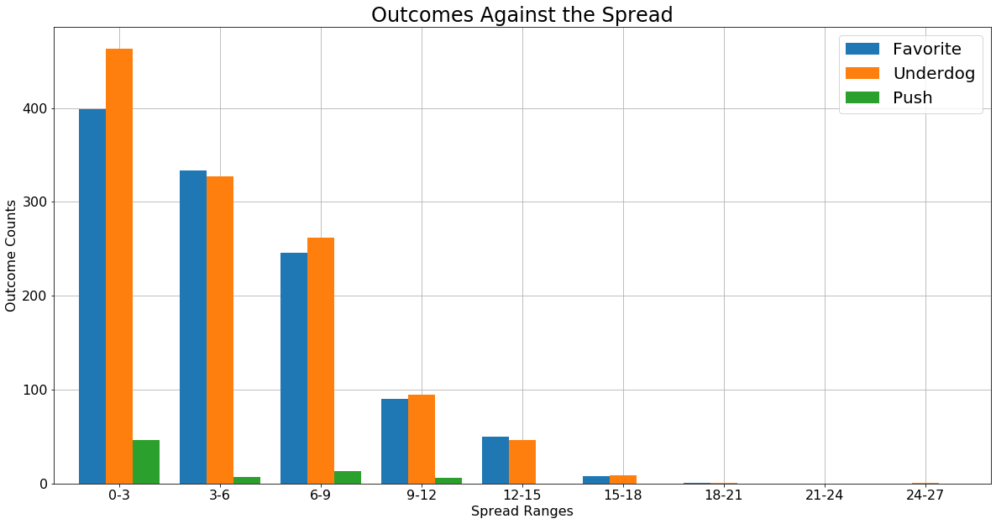
Base Gambling Outcomes: Spread

Slide 8
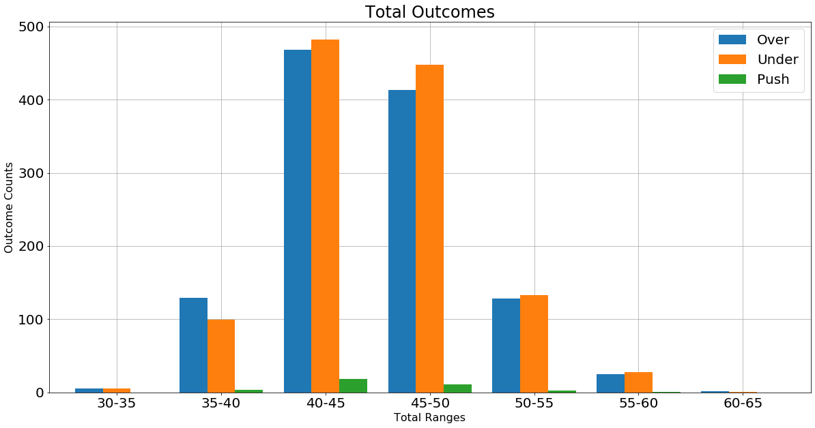
Base Gambling Outcomes: Totals

Slide 9
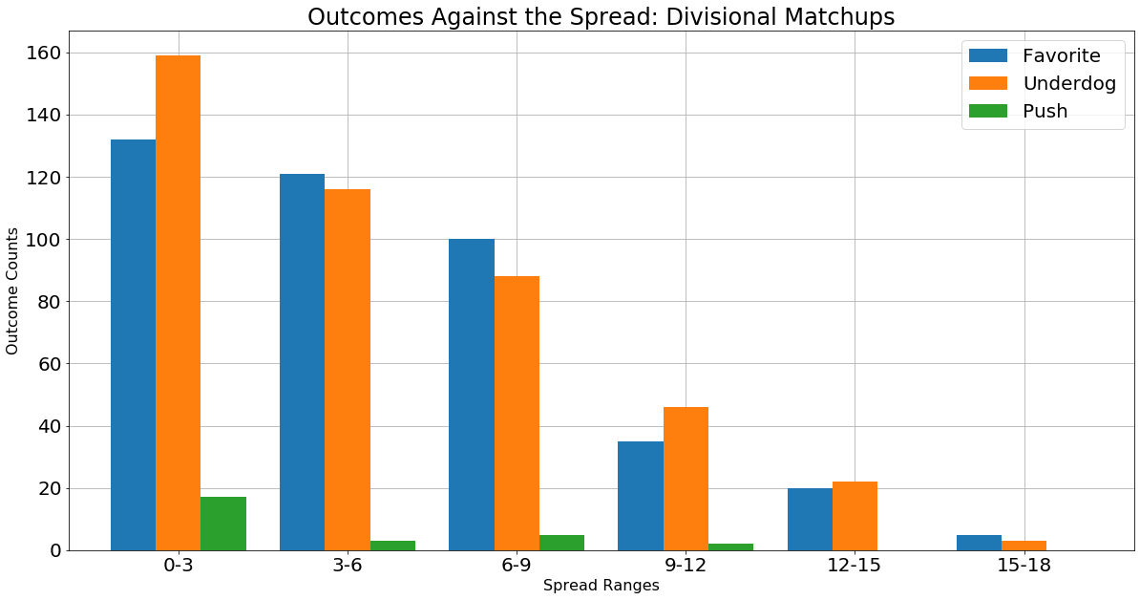
Divisional Matchups: Against the Spread

Slide 10
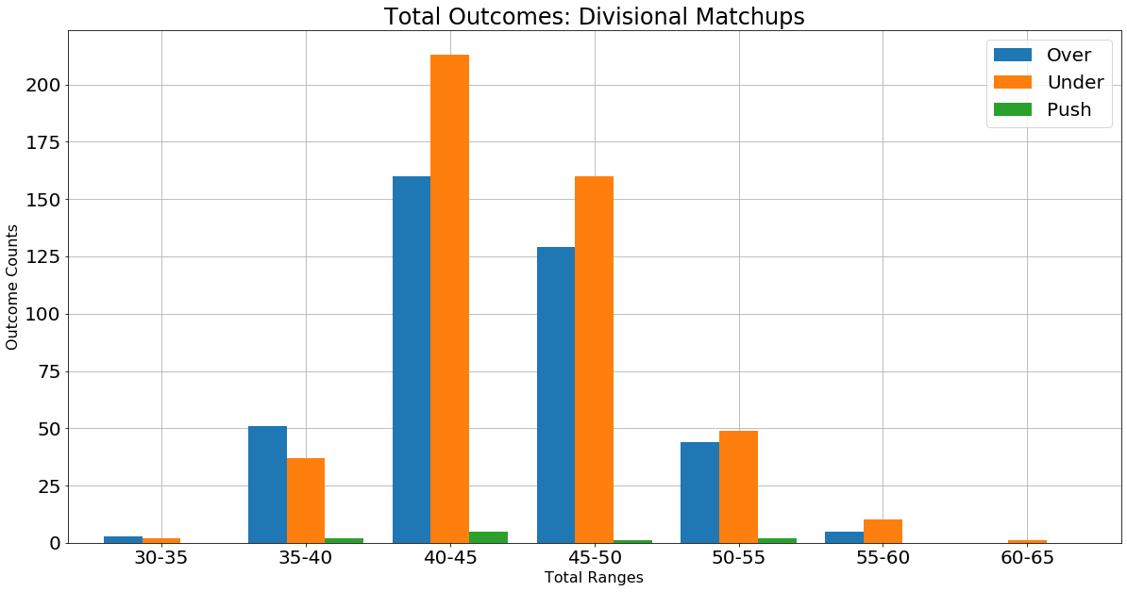
Divisional Matchups: Over/Under Totals

Slide 11
In Conclusion
In the grand scheme, Vegas is, indeed, always right.

Slide 12
Gambling is, statistically, a foolish pastime.

Slide 13
I will continue anyways.

Slide 14
Bet the Patriots
*If you or someone you know has a gambling problem, Call 1-800-GAMBLER or 1-800-848-1880

